Slide 1
Vision PLUS Print Routines 8.0

Slide 2
Why we need Print Routines?
Routines provide an easier and faster way to write code to access and perform certain pre-defined standard report print functions.
Provide formatted layouts
Transparency to the print commands

Slide 3
Parameters for print routines
The routine has parameters that allows for multiple print files
Header Print lines
Detail Print lines
Number of lines per page

Slide 4
Print Files
100 print files can be printed using print routines in a single program.
They are controlled by 2 byte field called ‘Form code’, values of 00 to 99 can be assigned to it.
The DD names used in the JCL’s are ARPRT00 to ARPRT99 for form codes 00 to 99 respectively.
These print files can be assigned to SYSOUT or physical sequential files
Most of the PaySys reports can be configured to any of these form codes using online screen.

Slide 5
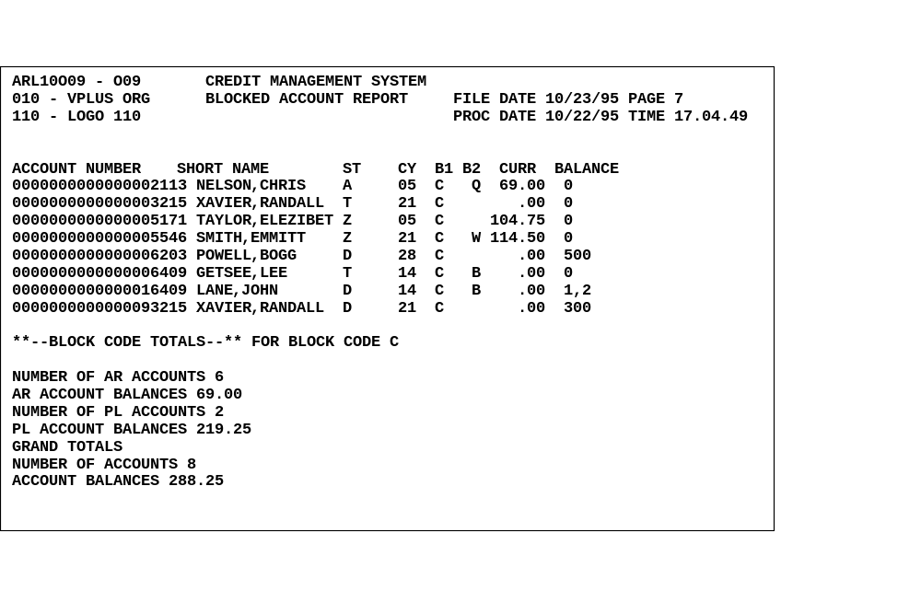
Standard Report Format
All the Vision Plus reports are printed in the format shown below

Slide 6
Header Lines
There are 7 Header lines defined in AR20WS , they are AR20WS-SH-L1 through AR20WS-SH-L7 (132) bytes in length.
If all these lines are spaced out, the header will not be printed. If any of the 7 lines have values other than spaces, then first 3 lines will always print.
Next 4 lines will print only if there is no spaces in each of the lines.
Headings are considered part of the line count.
We must provide file date in Line 2.

Slide 7
Header Lines… (Continued)
If the Processing date and time are not filled in, routine will populate system date and time in Line 3.
No specific perform is necessary for printing header lines.
Routine checks for the line count and page limit to advance to next page.
Also increments the page count and prints the header.
The page number is incremented automatically in the Line.
Tailoring header lines can be done by accessing the header line variables.
After the header a blank line is printed.

Slide 8
Line limit
Line limit is used to print total number of lines per page
If lines exceed the line limit, automatically the page is skipped and header is printed
Total number of lines is controlled thru AR20WS-LINE-LIMIT
By default AR20WS-LINE-LIMIT is set to 60

Slide 9
Detail Print Lines
Detail line to be printed needs to be moved to variable AR20WS-PRINT-LINE
The variable is 132 bytes in length
Good technique is to redefine the print line and use the data area for the detail print
Procedure to Print 1 line with no blank lines:
  MOVE <detail line> TO AR20WS-PRINT-LINE
PERFORM AR20PD-PRINT-1-LINE THRU
  AR20PD-P1L-EXIT
Prints the AR20WS-PRINT-LINE and advances carriage once.

Slide 10
Detail Print Lines… (continued)
Procedure to Print 1 line with 2 blank lines :
MOVE <detail line> TO AR20WS-PRINT-LINE
PERFORM AR20PD-PRINT-2-LINE THRU
  AR20PD-P2L-EXIT
  Prints the AR20WS-PRINT-LINE and advances carriage twice

Slide 11
Detail Print Lines… (continued)
Procedure to Print 1 line with 3 blank lines :
MOVE <detail line> TO AR20WS-PRINT-LINE
PERFORM AR20PD-PRINT-3-LINE THRU
  AR20PD-P3L-EXIT
  Prints the AR20WS-PRINT-LINE and advances carriage three times
  In all the above, the AR20WS-PRINT-LINE is defaulted to blanks after
  the print.

Slide 12
Double striking a line
If we need to double strike a line
MOVE <detail line> TO AR20WS-PRINT-LINE
PERFORM AR20PD-PRINT-0-LINE THRU
  AR20PD-P0L-EXIT
  This procedure prints a line without advancing the line

Slide 13
Forcing a Page Eject
To force a page eject,
  MOVE AR20WS-FORCE-PAGE TO
  AR20WS-LINE-COUNT
  Next subsequent perform of one of the routines will cause a page
  eject
The variable AR20WS-FORCE-PAGE contains value 900.
  When the AR20WS-LINE-COUNT is greater than the AR20WS-LINE-
  LIMIT the routine ejects a page

Slide 14
Closing the Print Files...
Before the main program is terminated all the print files need to be closed
To close the print files, Code
  PERFORM AR20PD-CLOSE-PRINT-FILES THRU
AR20PD-CPF-EXIT

Slide 15
Using Print Routines…Release 8.0
The copybooks related to the print routines are –
AR20WS - Print work area
AR00WS - Dynamic sub-routine list
SS01WS - Date work area
SS16PD - Output system date
AR20PD - Procedure division copybook
ARPRINT - Report printing Program

